Slide 1
UNIT 1
Introduction to Analog Electronics
Session-3
Transistor Amplifier: CE amplifier
Transistor Amplifier: CB and CC amplifier

Slide 2
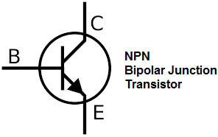
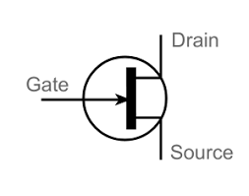
COMPARISON BETWEEN BJT AND JFET
BJT | JFET
Bipolar Device | Unipolar Device
Current Controlled Device | Voltage Controlled Device
Low Input Impedance | High Input Impedance
Consumes more power | Consumes less power
High Noise level | Low noise level
Low thermal stability | High thermal stability
Large size | Small size
Preferred in low current application | Preferred in low voltage application
High gain | Low – medium gain

Slide 3
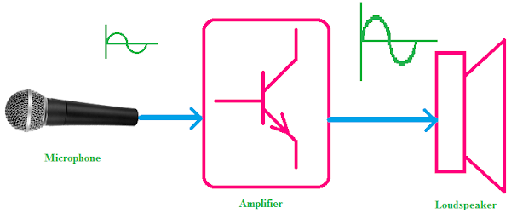
Transistor Amplifier
The transistor raises the strength of a weak signal and hence acts an amplifier
The transistor works as an amplifier in all configuration (CE, CB and CC)

Slide 4
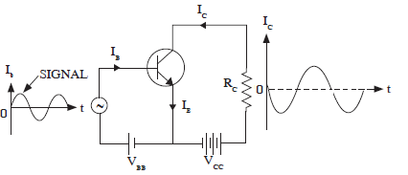
Transistor Amplifier: CE amplifier
npn transistor in CE mode
Input between Base and Emitter
Output between Collector and Emitter
Input current I_{B}
Output current I_{C}
Input junction (BE)-forward biased
Output junction (CE)-Reverse biased
The V_{BB} battery provides the forward bias
The V_{CC} battery provides the reverse bias
Notes:
1.npn transistor

Slide 5
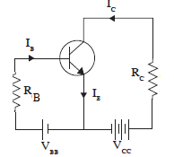

Write KVL in output circuit
Write KVL in Input circuit
V_{BB} = I_{B}R_{B}+V_{BE}

Slide 6
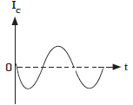

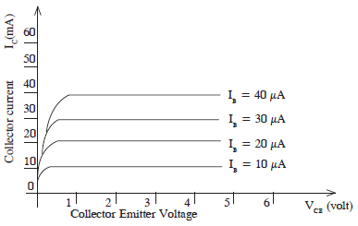
V_{BB}+V_{I}
Link between input and output current
I_{B} increases I_{C} increases
I_{B} decreases I_{C} decreases
Variation in collector current gives variation in output voltage
Transistor works as a amplifier in proper operating point

Slide 7
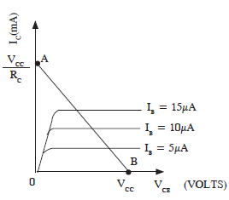

Load line
Each point of load line is the operating point of a transistor

Slide 8
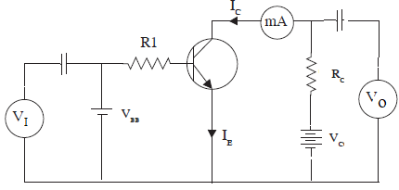
Amplifier
Capacitor connected to the input and output side remove DC component
I_{C} increases : V_{CE} voltage decreases
Voltage gain A_{V}=V_{CE}/V_{I}

Slide 9
Operation of Common Emitter Amplifier
When a signal is applied across the emitter-base junction during the positive half cycle the forward bias across this junction increases.
This increases the flow of electrons from the emitter to a collector through the base, thus increases the collector current.
The increasing collector current induces more voltage drops across the collector load resistor R_{C}.
The negative half cycle decreases the forward bias voltage across the emitter-base junction.
The decreasing collector-base voltage reduces the collector current in the whole collector resistor R_{C}.
Thus, the amplified load resistor appears across the collector resistor

Slide 10
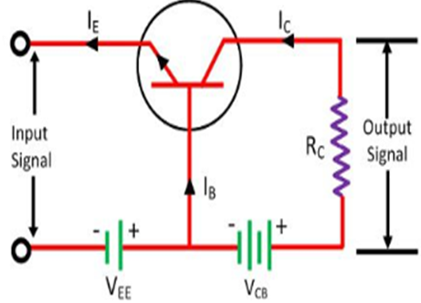
Common Base Transistor as an Amplifier
The emitter and base of the transistor are connected in forward biased and the collector base region is in reverse bias.
The input signal or weak signal is applied across the emitter base and the output is obtained to the load resistor R_{C} which is connected in the collector circuit.
The DC voltage V_{EE} is applied to the input circuit along with the input signal to achieve the amplification
When a weak signal is applied to the input, a small change in signal voltage causes a change in emitter current (or we can say a change of 0.1V in signal voltage causes a change of 1mA in the emitter current) because the input circuit has very low resistance.
This change is almost the same in collector current because of the transmitter action.
In the collector circuit, a load resistor R_{C} of high value is connected.
When collector current flows through such a high resistance, it produces a large voltage drop across it.
Thus, a weak signal (0.1V) applied to the input circuit appears in the amplified form (10V) in the collector circuit.

Slide 11
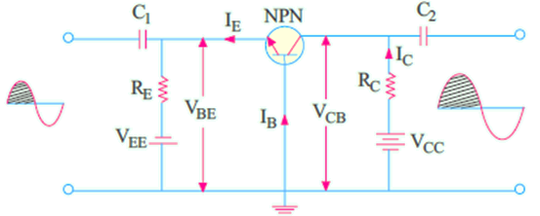
Common Base (CB) Amplifier
When positive half-cycle of the signal is applied, then
forward bias is decreased because V_{BE} is already negative with respect to the ground
2. consequently, I_{B} is decreased.
3. I_{E} and hence I_{C} are decreased
4. The drop I_{C} R_{C} is decreased.
5. Hence, V_{CB} is increased
Since a positive-going input signal produces a positive-going output signal, there is no phase reversal
Voltage amplification in this circuit is possible by reason of relative input and output circuitry rather than current gain (α) which is always less than unity.
The input circuit has low resistance whereas output circuit has very large resistance.
Although changes in input and output currents are the same, the ac drop across RL is very large.
Hence, changes in VCB (which is the output voltage) are much larger than changes in input ac signal. Hence, the voltage amplification.

Slide 12
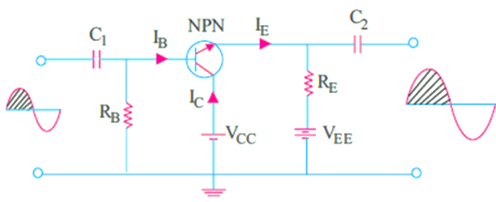
Common Collector (CC) Amplifier
1. forward bias is increased since VBE is positive
w.r.t. collector i.e. ground,
2. base current is increased,
3. emitter current is increased,
4. drop across RE is increased,
5. hence, output voltage (i.e. drop across RE is
increased.
When a positive-going input signal results in a positive going output signal and, consequently, the input and output signals are in phase

